Slide 1
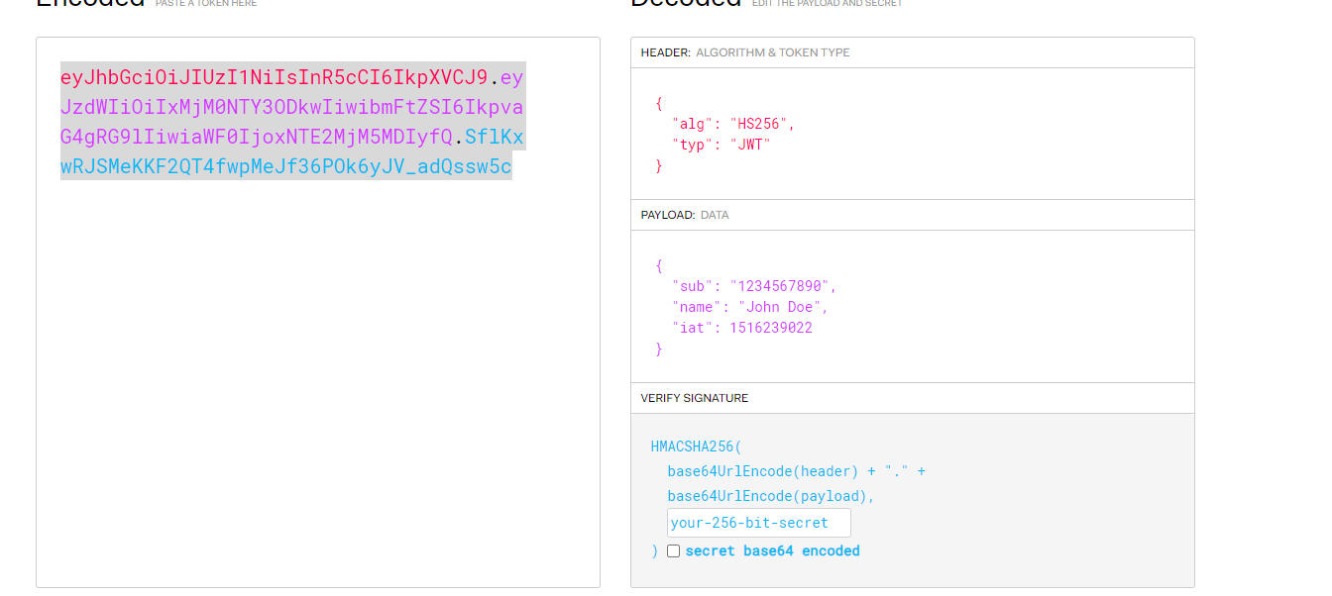
JWT Token
JWT Token is a secure message
JWT Can also be also to do secret message, but we don’t use this feature (not very common to do that)

Slide 2
Consists of three parts
Header, Payload and Signature
-Header: You can put what algo you will be using the sign message
-Payload: You put JSON message – common json asson attributes (understood by openid etc)
“iss”: who issued this message
“sub” : subject
“exp” : when this message should be considered expired
“aud” who the intended audience is for this message
Other commonly understood attributes ((jti, given_name, family_name)
https://www.iana.org/assignments/jwt/jwt.xhtml
plus you can have any other json attributes you want - Signature: You sign the header + payload. Such that if you’ll know if anyone has either tampered with the header + message

Slide 3
Side Note
JWT is a form of Structure Token
A structured token is simple token that anyone can extract some or all information from examining the token without having to call the authorization server.
There is something else called Opaque Token
An opaque token e.g. :
9898833dsfsa2faxyad
These tokens have no meaning to anyone else, you need to contact to the authorization to get information assosiated for this token.

Slide 4
How it works
Autorization server 1
Issuer : issuer-abc
A well written authorization server will only issue the secure message (JWT) after it has AUTHENTICATED the client
Client want to talk to “Resource Server” but resource server insists on valid JWT to be presented to it before server it’s request
Client has to first get a token from an Authorization Server
Or
Autorization server 2
Issuer : issuer-xyz
A well written authorization server will only issue the secure message (JWT) after it has AUTHENTICATED the client

Slide 5
How it works
Client has token from Authorization Server
Now it’s able to send request to Resource Server (e.g maybe a REST call to get Customer data )
Resource Server
Will accept token from either
issuer : abc or issuer : xyz
If the token is valid, the resource server will process the request (in this case REST call to get Customer data)

